Slide 1
Topic: Helping Your Staff Get to 100% By Asking for Increases Guest Speaker: Gabe Buchholtz May 30,2017 1:00 pm

Slide 2
SRS Webinars are a membership benefit of the SRS Network For more information about the SRS Network visit: www.supportraisingsolutions.org/network-membership

Slide 3
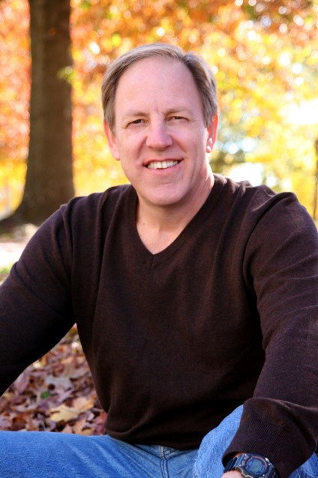
Steve Shadrach
Moderator
Executive Director of the Center for Mission Mobilization & Founder of Support Raising Solutions

Slide 4
Discount Price
Today and tomorrow only!
Get 20% off
Regularly Priced $17.99
Promo code: SRS20
cmmpress.org/blindspots

Slide 5
Fall Facilitator Training Dates Set!
\
September 10th – 12th in Rogers, AR

Slide 6
Save the Date!
Support Raising Leader’s Conference
February 6-9 2018
Mission Inn Resort and Club – Orlando, FL
More information coming soon!

Slide 7
Prayer

Slide 8
Questions
During the presentation, please submit your questions for the upcoming Q&A time.

Slide 9
Gabe Buchholtz
Guest Speaker
International Representative
FamilyLife Global Team

Slide 10
Helping Your Staff Get to 100%
By Asking for Increases

Slide 11
Overview
The One Big Question
The One Big Answer
The Very Real Need
The Very Successful Solution

Slide 12
Why Contact Current Donor Partners?
Partners are committed
They have a track record
Personal relationship
Most likely to respond
Opportunity to connect
Many say YES!!!

Slide 13
Assumptions
Pay raises, promotions and cost of living increases
When income increases, the tithe increases
Increased donor giving—to you or someone else
Regular increase asks generate automatic increases

Slide 14
Reasons Your Staff Might NOT Ask for Increases:
If I ask, donor might be offended
I previously asked, donor said no
Donor previously increased their gift
Have kids in college
On a tight budget
Simply not considered it
Donor may be hurting financially

Slide 15
Action Steps: How to
Team up with a buddy—accountability
Schedule it. Part time job—weekly hours.
Draft your appeal letter. Get it reviewed.
Large photo of you/family.
Organize your donor list. Segment it by amount—largest first.
Plan to ask every two years
How much to ask?

Slide 16
Strategies to Get Feedback (A Decision)
Call ahead—plan to leave a voice message
Call after—plan to leave a voice message
Sample voice message (if you call on Tuesday): “I’ll try to reach you again tomorrow night; if I miss you I’ll try again on Saturday.”
Email follow-up strategy
Facebook follow-up strategy

