Slide 1
^{Live online presentations} ^{helping you create a culture} ^{of a fully funded ministry.}

Slide 2
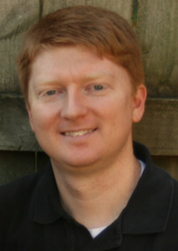
Moderator Introduction
John Patton– COO of the Center for Mission Mobilization and co-founder of SRS and the CMM

Slide 3
Introduction
SRS Vision
We want to flood the nations with
Spiritually healthy,
Vision-driven,
Fully funded Great Commission workers

Slide 4
Introduction
Our Goal
SRS provides solutions to help your staff overcome obstacles, maintain a God-centered perspective, and apply proven strategies to personal support raising.
We want to help you create a culture of a fully funded ministry for:
Recruits
New Staff
Veteran Staff
Support raising trainers and coaches

Slide 5
Introduction
Ongoing Benefits of the SRS Network
Monthly Webinars
Opportunity to utilize SRS Bootcamp curriculum
Audit Survey
Catapult Series
Training for you as facilitators
Support Raising Leaders Conference

Slide 6
Stop and Mark Your Calendar!
Last Tuesday of each month 1 p.m. CST
Please create a recurring event in your calendar

Slide 7
Spring Facilitator Training Dates Set!
April 17 pm -19 pm in Rogers, AR

Slide 8
^{Prayer}

Slide 9
Questions
During the presentation, please submit your questions for the upcoming Q&A time

Slide 10
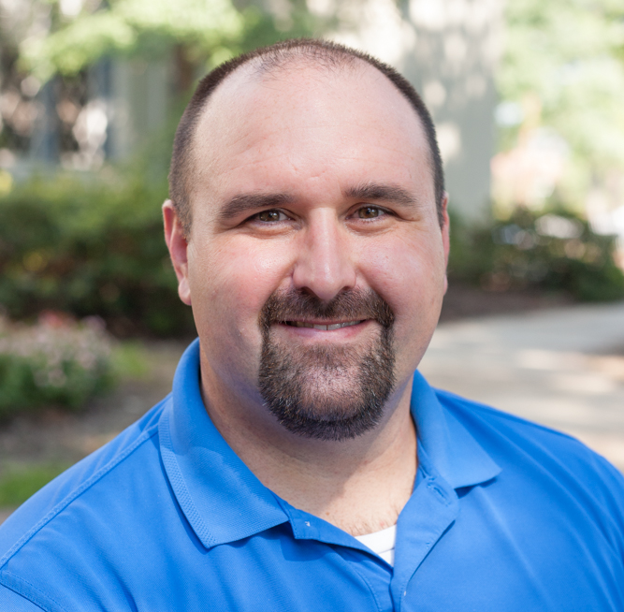
Guest Speaker Introduction
Luke Niday– Global Resource Director, Campus Outreach
Augusta, GA
13 years of being fully funded Admin staff

Slide 11
Cracking the Code to Being
Fully-Funded Administrative Staff

Slide 12
Overview
My Start/Story
Role of Resource
Understanding our Gifting as administrative people
Understanding our Mission as administrative people
Re-Envision Identity; Re-Invision Role
Activity

Slide 13
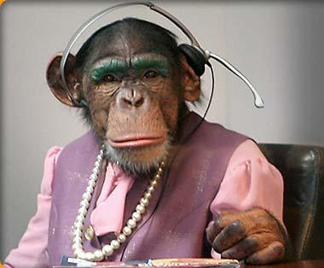
My Start/Story
”Office Monkey” vs. ”Resource Staff”

Slide 14
Role Of Resource
Behind the Scenes Not Behind the Front Lines
Who was the first martyr?
What part of the body are we?
1 Corinthians 12:12-28
Romans 12:1-8
Not the same role, but not less valuable!!

Slide 15
Understanding the Gifting Administrative People
Don’t try to do what you aren’t gifted to do
Learning to serve in a leadership driven world
Understand the community of administrative people
Vision leaks
Build community
Spend time in campus staff shoes
Different gifting

Slide 16
Understanding the Mission of Administrative People
CO Start
Mission of CO
Laborers
What we don’t do vs. what we do do

Slide 17
Breaking Cycles of SRB
How did I break free of SRB (not done yet)
I worked hard. Minimum of 10 face-to-face appointments per week. 50+ hours many weeks.
I asked radically. 100% increase for 3 years at every appointment.
I raised support in community.
I asked a few for more than my personal ministry. In fact, I was willing to sacrifice it.

Slide 18
Re-Envision and Re-Invision
Bible studies

Slide 19
Re-Envision and Re-Invision
Bible studies Develop effective resources

Slide 20
Re-Envision and Re-Invision
Bible studies Develop effective resources
Support updates

Slide 21
Re-Envision and Re-Invision
Bible studies Develop effective resources
Support updates Keep ministry partners informed

Slide 22
Re-Envision and Re-Invision
Bible studies Develop effective resources
Support updates Keep ministry partners informed
Events

Slide 23
Re-Envision and Re-Invision
Bible studies Develop effective resources
Support updates Keep ministry partners informed
Events Create spaces for the Spirit of God to move

Slide 24
Final Thoughts
I want to take some time and have you analyze.. If you are a resource staff, How would you grade yourself? If you are a ministry executive, how would you grade your team?
______ Identity
______ Using my Gifting
______ Living in community
______ Living with a missional vision
Take a few minutes and pray through and grade yourself. What promises do you need to claim? What adjustments could you make? How can you keep vision from leaking? How can you change your office lingo?

Slide 25
Managing Yourself During Support Raising
^{Q&A}
As Leaders and Support Trainers – What to Secure and Establish
Checking on Team Support levels
Staff reporting on support maintenance time
Allocating time for SMD
Share staff experiences

Slide 26
Closing
Join us next month:
April 28 at 1 p.m. CST

