Slide 1
^{Live online presentations} ^{helping you create a culture} ^{of a fully funded ministry.}

Slide 2
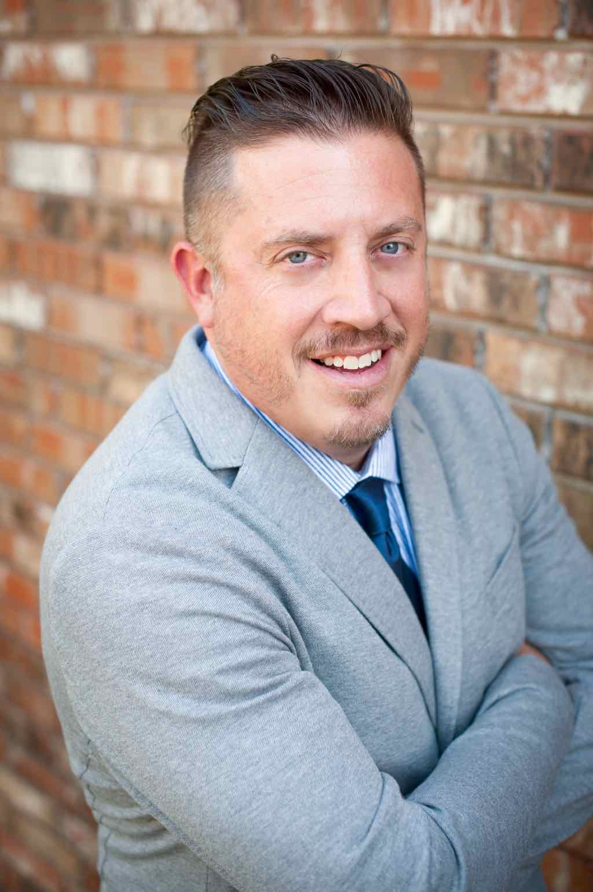
Moderator Introduction
Aaron J. Babyar – SRS Managing Director

Slide 3
Introduction
SRS Vision
We want to flood the nations with
Spiritually healthy,
Vision-driven,
Fully funded Great Commission workers

Slide 4
Introduction
Our Goal
SRS provides solutions to help your staff overcome obstacles, maintain a God-centered perspective, and apply proven strategies to personal support raising.
We want to help you create a culture of a fully funded ministry for:
Recruits
New Staff
Veteran Staff
Support raising trainers and coaches

Slide 5
Introduction
Ongoing Benefits of the SRS Network
Monthly Webinars
Opportunity to utilize SRS Bootcamp curriculum
Audit Survey
Catapult Series
Training for you as facilitators
Support Raising Leaders Conference

Slide 6
Spring Facilitator Training Dates Set!
April 18-19 in Rogers, AR

Slide 7
Stop and Mark Your Calendar!
Last Tuesday of each month 1 p.m. CST

Slide 8
^{Prayer}

Slide 9
Questions
During the presentation, please submit your questions for the upcoming Q&A time

Slide 10
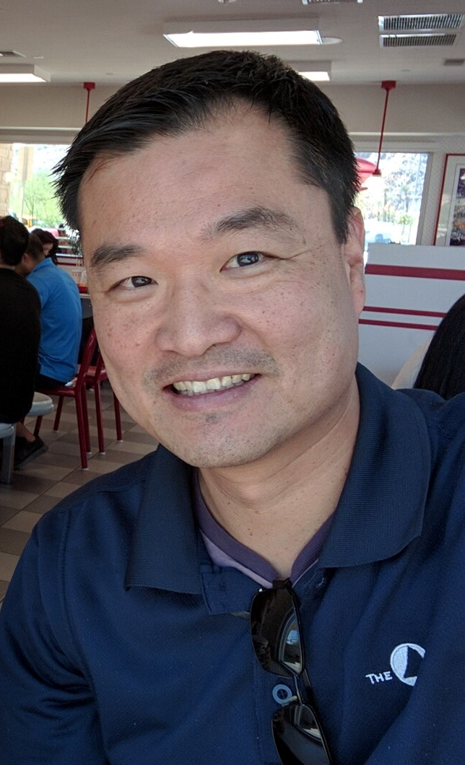
Guest Speaker
Kennex (Ken) Chi– The Navigators Collegiate Ethnic Development & International Staff Funding Coach

Slide 11
Dynamics of Shame & Honor
In Support Raising

Slide 12
Personal Background
Born in Taiwan
Large extended family, all church-going
1983 Immigrated to US, age 12
Met The Navigators at Oregon State University
Joined staff 1996, started raising support
Struggles & Breakthrough in funding
Transformation on MPD perspectives

Slide 13
Dynamics of Shame & Honor in Funding
What is Shame? Honor?
Shame: I AM wrong; something is wrong with ME!
Guilt: I DID something wrong, behavior
Shame often experienced through ideals, expectations, and community contexts
Honor: Acknowledgement of worth/value, acceptance from community

Slide 14
Dynamics of Shame & Honor in Funding
Shame & Honor in the Bible: John 2:1-11
Importance of the wedding celebration, presence of wine for guests: Hospitality!
Small town community: everyone knows everything!
Life-long embarrassment: They are the couple who ran out of wine at their wedding!
Jesus removes the potential life-long shame, replaced with honor: They are the couple who brought out the better wine later!

Slide 15
Dynamics of Shame & Honor in Funding
Shame-based (East) Culture vs. Guilt-based (West) Culture
Group Orientation |  | Individual Orientation
Inclusion Achievement of goals set by others Obligation to group |  | Autonomy Achievement of individual goals Trained to be individuals
Duty and Obligation |  | Rights and Privilege
Relational responsibility Duty to others Motivation based on obligation |  | Responsible to self Personal rights Motivation based on feelings

Slide 16
Dynamics of Shame & Honor in Funding
Shame-based (East) Culture vs. Guilt-based (West) Culture
Harmony (Relationship) |  | Efficiency (Task)
Experience and intuition Focus is on building relationships Interconnected and holistic |  | Reason Focus is on keeping good time Linear and compartmentalized
Hierarchy |  | Equality
Submissive to authority Emphasis on positions in relationship Accepts rules and propriety |  | Questions authority Play down positions of superior and subordinate Dislike for rules and subjection

Slide 17
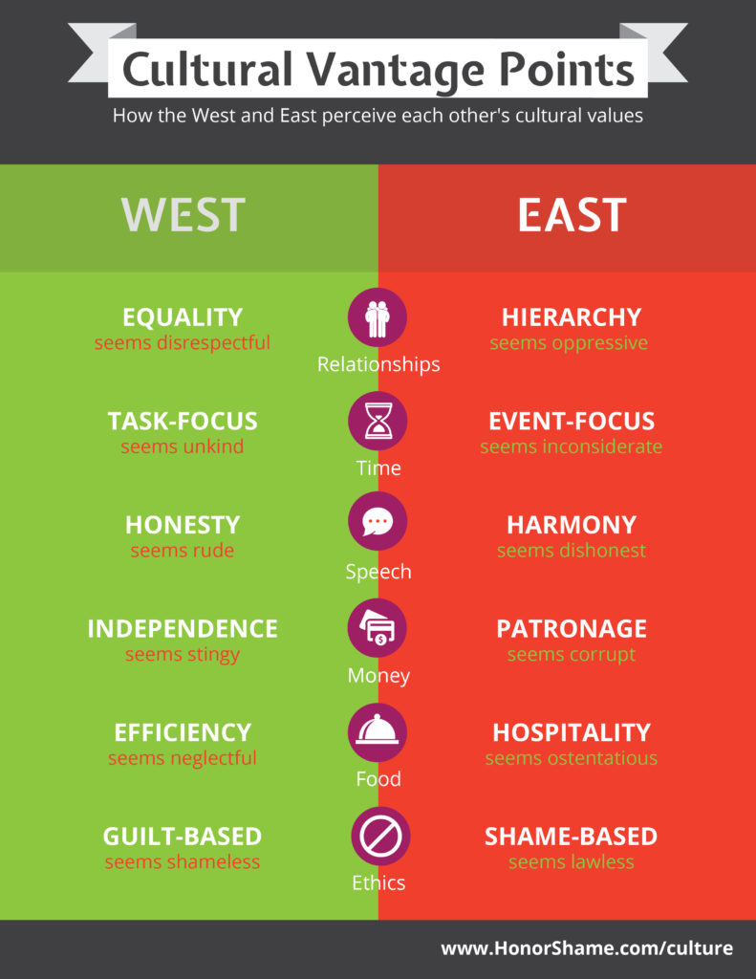

Slide 18
Dynamics of Shame & Honor in Funding
Dynamics applied in fundraising
Acknowledge age hierarchy & respect: address with proper honorific titles, customs of greeting (shoes off? bowing, hand-shake, etc.), be very thankful!
Practice hospitality and Host/Guest roles: what would be an appropriate gift? How can I contribute to our time together? Don’t expose potential shame of host.

Slide 19
Dynamics of Shame & Honor in Funding
Dynamics applied in fundraising
Maintain harmony: avoid arguments on why support-raising is biblical, or if 10% is enough! Utilize inclusive words like “us, we” instead of “me, they”.
Promote freedom & honor generosity: “The decision is strictly between you (your family) and God, and I’m so honored to have this opportunity to share with you, and I believe God is glorified by your thoughtful consideration.”

Slide 20
Managing Yourself During Support Raising
^{Q&A}
As Leaders and Support Trainers – What to Secure and Establish
Checking on Team Support levels
Staff reporting on support maintenance time
Allocating time for SMD
Share staff experiences

Slide 21
Closing
Join us next month:
Jan. 31 at 1 p.m. CST

