Slide 1
^{Live online presentations} ^{helping you create a culture} ^{of a fully funded ministry.}

Slide 2
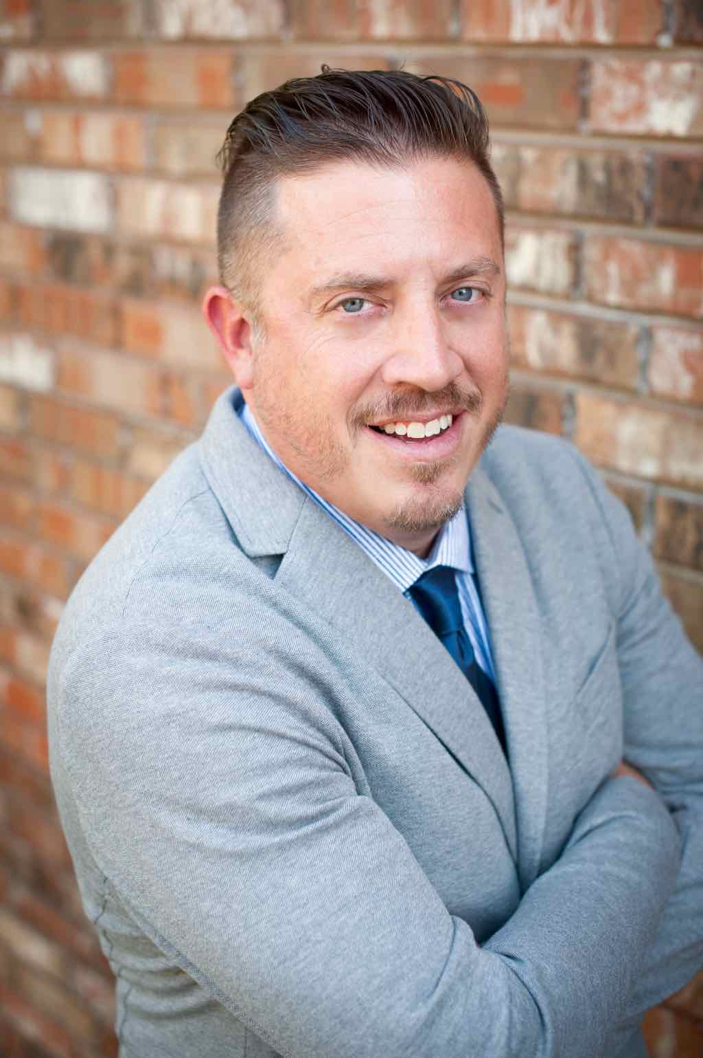
Moderator Introduction
Aaron J. Babyar – SRS Managing Director

Slide 3
Introduction
SRS Vision
We want to flood the nations with
Spiritually healthy,
Vision-driven,
Fully funded Great Commission workers

Slide 4
Introduction
Our Goal
SRS provides solutions to help your staff overcome obstacles, maintain a God-centered perspective, and apply proven strategies to personal support raising.
We want to help you create a culture of a fully funded ministry for:
Recruits
New Staff
Veteran Staff
Support raising trainers and coaches

Slide 5
Introduction
Ongoing Benefits of the SRS Network
Monthly Webinars
Opportunity to utilize SRS Bootcamp curriculum
Audit Survey
Catapult Series
Training for you as facilitators
Support Raising Leaders Conference

Slide 6
Stop and Mark Your Calendar!
Last Tuesday of each month 1 p.m. CST
Please create a recurring event in your calendar
You’ll receive an email invite monthly

Slide 7
^{Prayer}

Slide 8
Questions
During the presentation, please submit your questions for the upcoming Q&A time

Slide 9
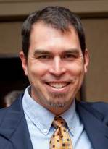
Moderator Introduction
John Allert – CMM East Africa Catalytic Director

Slide 10
Breaking Free from
Support Raising Bondage (SRB)

Slide 11
Overview
My Story
What I hope you get out of this
Lies I believed
How I am breaking the cycle
What has it meant to my family and ministry?
What would I say to others coaching those in SRB?

Slide 12
Breaking Cycles of SRB
My Story
Family of 6, currently in Nairobi
18 years on support, over $2M
Trained well
Our beginnings on support
Crisis management approach
Effects on marriage and ministry
Effects on team and others counting on me
Missed opportunities

Slide 13
Breaking Cycles of SRB
Goals of Today’s Presentation
You would be encouraged and inspired
There is hope. God can. You are vital.
Practical tips to help others
Be real with you and answer questions

Slide 14
Breaking Cycles of SRB
Lies
The mission is more important than adequate funding.
Serving in full-time ministry is a special call to God-honoring poverty or at least not worrying about money.
Both are partially true.

Slide 15
Breaking Cycles of SRB
How did I break free of SRB (not done yet)
God convicted me. He is working in your staff.
I made a commitment to boss and wife publically to be at 100% or more.
I had a great role model of health, generosity, and good communication.
I moved overseas which provided urgency and compelling vision, two critical factors.

Slide 16
Breaking Cycles of SRB
How did I break free of SRB (not done yet)
I worked hard. Minimum of 10 face-to-face appointments per week. 50+ hours many weeks.
I asked radically. 100% increase for 3 years at every appointment.
I raised support in community.
I asked a few for more than my personal ministry. In fact, I was willing to sacrifice it.

Slide 17
Breaking Cycles of SRB
What has it meant to family and ministry?
I am more generous with wife, family, and team.
We are more generous in our giving. Give radically.
We have been able to focus on the mission much more. 25% of my time (much unplanned) versus ~5% (planned).

Slide 18
Breaking Cycles of SRB
What has it meant to family and ministry?
I am able to do all that the vision requires including travel, send others, sufficient materials, and retreats.
I spend less time and effort on support.
The whole family is healthier—life more normal/sane, better rest, better team player, finances no longer a constant stressor, and marriage is stronger
No debt of any kind.

Slide 19
Breaking Cycles of SRB
Tips to help others out of SRB
Be FOR your staff’s fruitfulness, ministry, marriage, and team. That is your motive.
100% or more from day one. 110% is better. If God can provide 80%, He can also do 100%.
Build structures to catch deficits early and change culture: Ask each week, new budget/goal each year that they see, program for those in SRB, ask wives, 100% or mandatory helps to get them back to 100%.

Slide 20
Breaking Cycles of SRB
Tips to help others out of SRB
Help them develop vision-driven budgets/goals.
Win, keep, raise.
Help people discover lies, traditions, cultural baggage that keep them in SRB. Refresher every 3 years.
Dream with them. Keep the dream in front of them.

Slide 21
Managing Yourself During Support Raising
^{Q&A}
As Leaders and Support Trainers – What to Secure and Establish
Checking on Team Support levels
Staff reporting on support maintenance time
Allocating time for SMD
Share staff experiences

Slide 22
Closing
Join us next month:
Dec. 27 at 1 p.m. CST

