Slide 1
^{Live online presentations} ^{helping you create a culture} ^{of a fully funded ministry.}

Slide 2
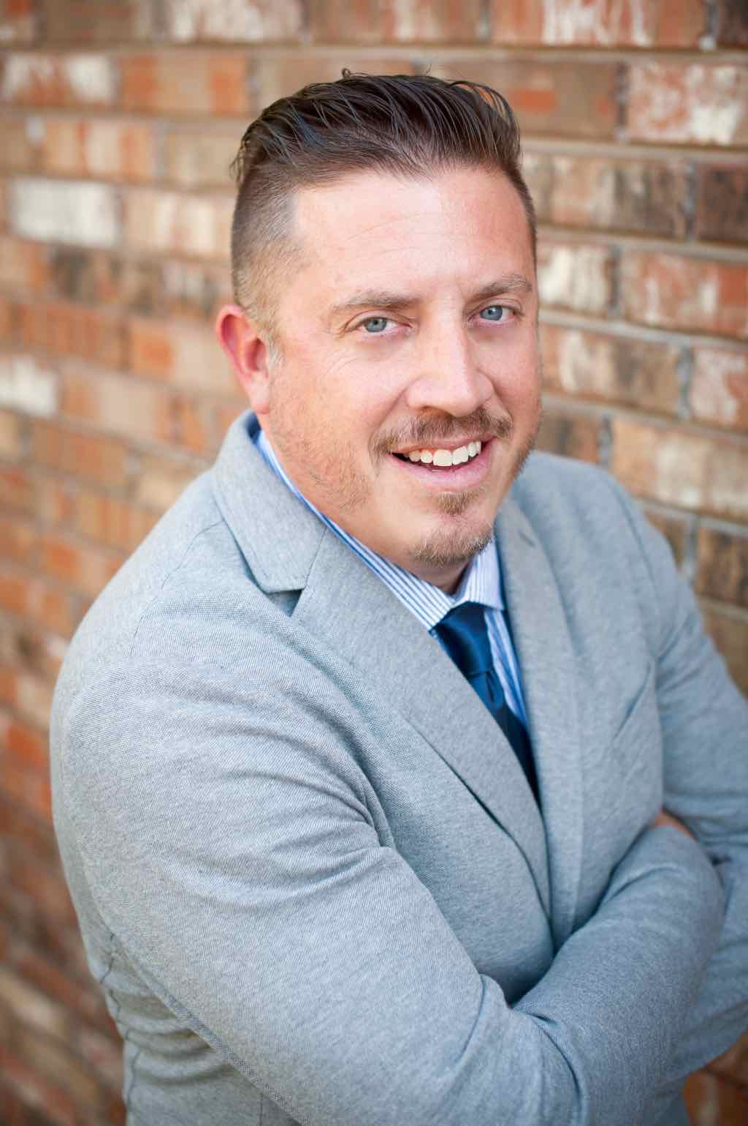
Moderator Introduction
Aaron J. Babyar – SRS Managing Director

Slide 3
Introduction
SRS Vision
We want to flood the nations with
Spiritually healthy,
Vision-driven,
Fully funded Great Commission workers

Slide 4
Introduction
Our Goal
SRS provides solutions to help your staff overcome obstacles, maintain a God-centered perspective, and apply proven strategies to personal support raising.
We want to help you create a culture of a fully funded ministry for:
Recruits
New Staff
Veteran Staff
Support raising trainers and coaches

Slide 5
Introduction
Ongoing Benefits of the SRS Network
Monthly Webinars
Opportunity to utilize SRS Bootcamp curriculum
Audit Survey
Catapult Series
Training for you as facilitators
Facilitator’s Training folded in with Support Raising Leaders Conference

Slide 7
Stop and Mark Your Calendar!
Last Tuesday of each month 1 p.m. CST
Please create a recurring event in your calendar
You’ll receive an email invite monthly

Slide 8
^{Prayer}

Slide 9
Questions
During the presentation, please submit your questions for the upcoming Q&A time

Slide 10
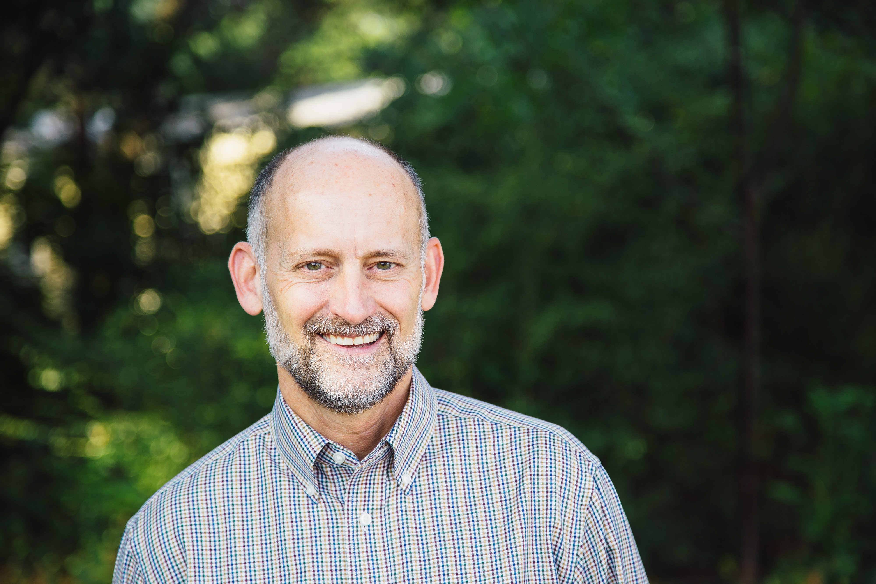
Presenter Introduction
Jeff Jackson — Pioneer Bible Translators

Slide 11
^{Implementing Strategic Prayer}
^{Practically in Support Raising}

Slide 12
Pioneer Bible Translators – Annual Income

Slide 13
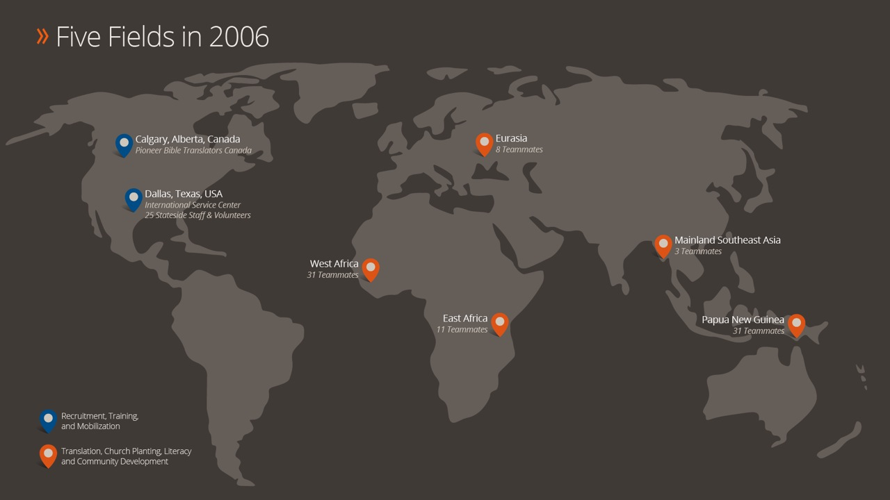
Pioneer Bible Translators – Fields

Slide 14
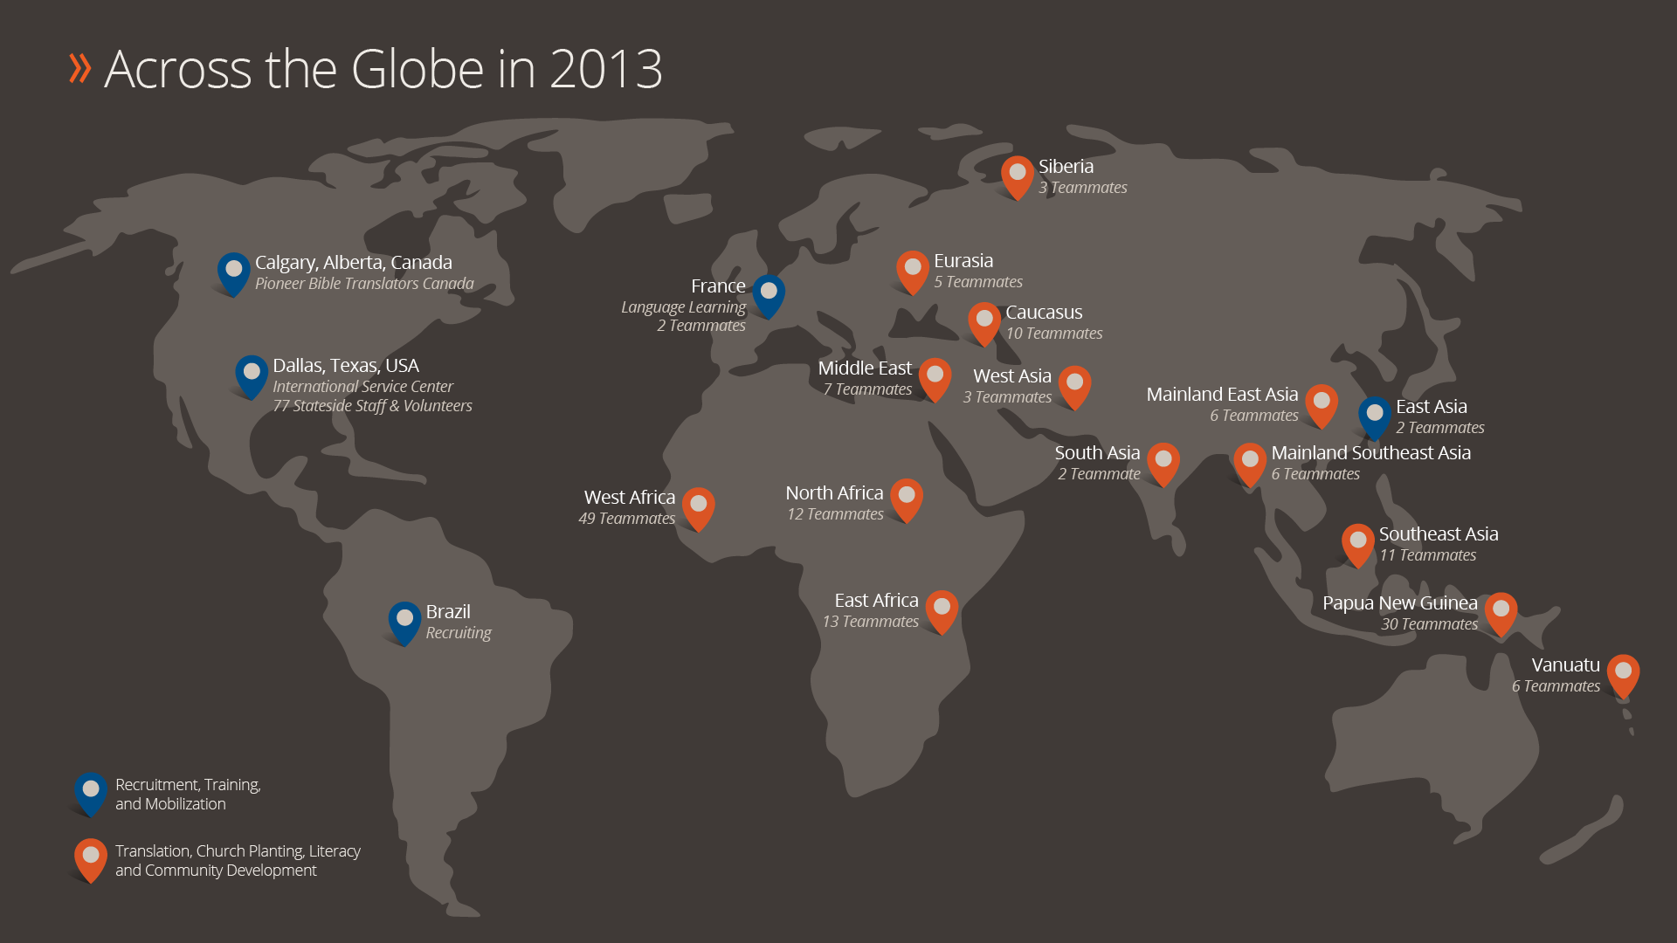
Pioneer Bible Translators

Slide 15
Pioneer Bible Translators

Slide 16
Implementing Prayer as a Strategy
Adoration: worshipping God for who He is
Confession: admitting and repenting of our sin
Thanksgiving: lifting up our gratitude for what God has done
Intercession/Supplication: praying for ourselves and others
Vanquishing Satan: practicing regular spiritual warfare
Extreme Prayer: maximizing all the prayer promises of Jesus

Slide 17
Things to Ponder
What does in Jesus’ name mean?
How can your ministry pray in Jesus’ name?
What has Jesus commanded in the Bible that your ministry should do in your community or world?
Spend time praying for God to reveal his will for you and your ministry. What do you think He desires for you to do as a result of those revelations?

Slide 18
Things to Ponder
What unattainable resources do you need in order to do Jesus’ will in your community or the world? What insurmountable obstacles stand in the way?
Make a list of prayer requests designed to help you and your ministry overcome those obstacles and obey Jesus’ commands more fully.

Slide 19
Managing Yourself During Support Raising
^{Q&A}
As Leaders and Support Trainers – What to Secure and Establish
Checking on Team Support levels
Staff reporting on support maintenance time
Allocating time for SMD
Share staff experiences

Slide 20
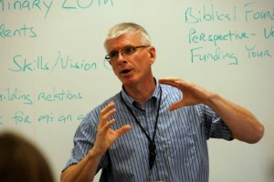
Closing
Join us next month: June 28 at 1 p.m. CST
Doug Christensen
Deputy Finance Director for SIM

