Slide 1
^{Live online presentations} ^{helping you create a culture} ^{of a fully funded ministry.}

Slide 2
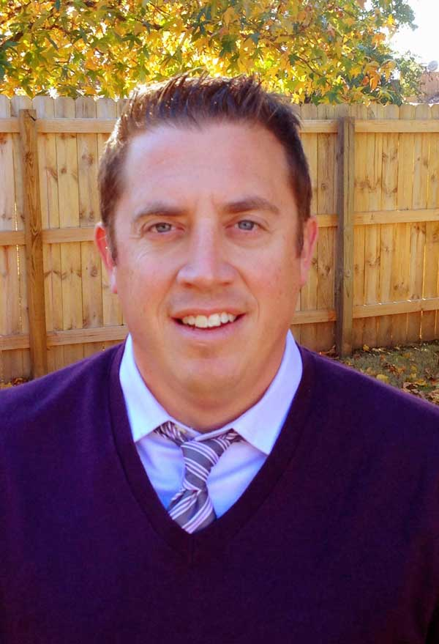
Moderator Introduction
Aaron J. Babyar – SRS Managing Director

Slide 3
Introduction
SRS Vision
We want to flood the nations with
Spiritually healthy,
Vision-driven,
Fully funded Great Commission workers

Slide 4
Introduction
Our Goal
SRS provides solutions to help your staff overcome obstacles, maintain a God-centered perspective, and apply proven strategies to personal support raising.
We want to help you create a culture of a fully funded ministry for:
Recruits
New Staff
Veteran Staff
Support raising trainers and coaches

Slide 5
Introduction
Ongoing Benefits of the SRS Network
Monthly Webinars
Training for you as facilitators (SRS Facilitators Training: Oct. 20-21)
Opportunity to utilize SRS Bootcamp curriculum
Audit Survey (Now Available)

Slide 6
Stop and Mark Your Calendar!
SRS Certified Facilitators Training— Oct. 20-21

Slide 7
Stop and Mark Your Calendar!
Last Tuesday of each month 1 p.m. CST
Please create a recurring event in your calendar
You’ll receive an email invite monthly, please plan to ACCEPT it each time

Slide 8
^{Prayer}

Slide 9
Questions
During the presentation, please submit your questions for the upcoming Q&A time

Slide 10
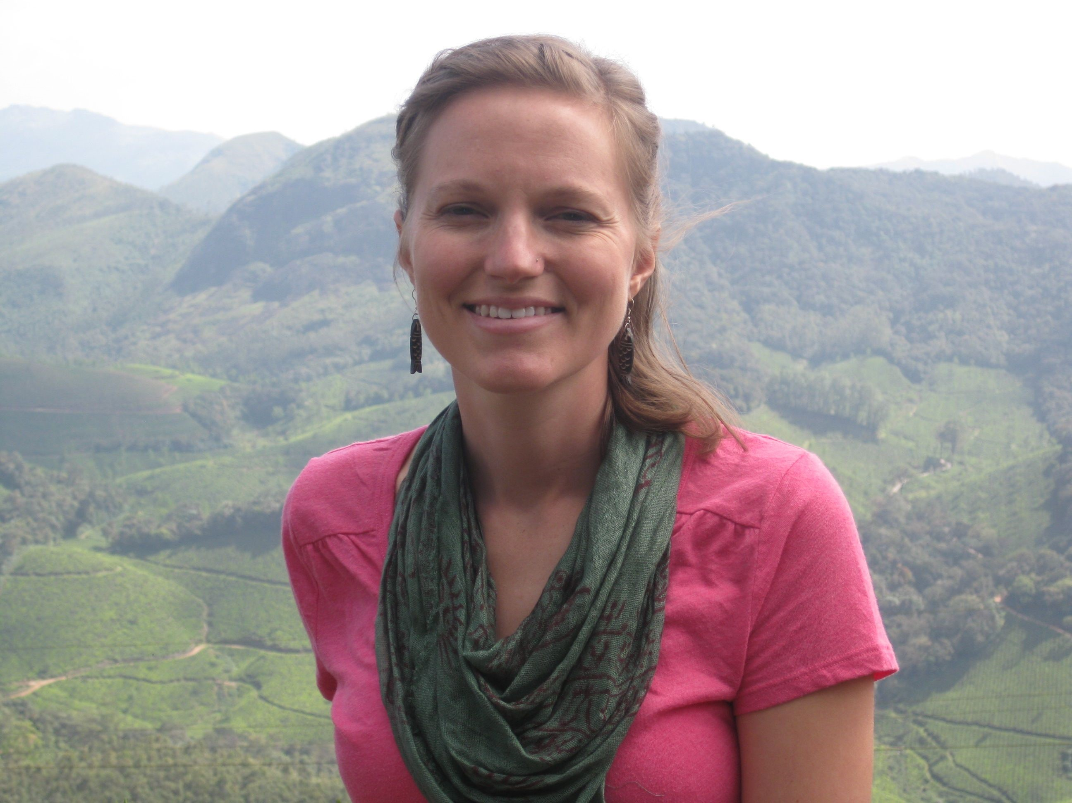
Presenter Introduction
Lisa Freyenberger – Frontier Ventures

Slide 11
^{How to Develop Conditions to}
^{Maintain Being Fully Funded}

Slide 12
Creating the Conditions for Provision
While we cannot transform ourselves into the image of Christ, we can create the conditions in which spiritual transformation can take place.
- Ruth Hayley Barton
While we cannot predict or control how God will choose to provide a ministry team, we can create the conditions in which he often chooses to do so.
Notes:
Barton, Ruth H. Biblical and theological perspective on spiritual transformation: An interactive process for groups. Transforming Resources. 2012.
Cultivate conditions in three areas: Ministry Team Development, Ministry Team Maintenance, and Leading Others
- First tell a bit of my story and then name the conditions

Slide 13
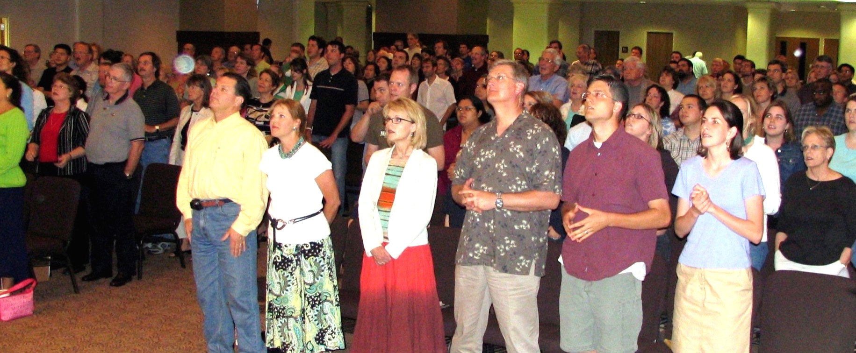
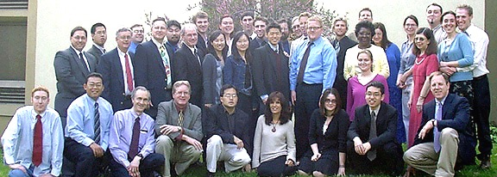
Notes:
Ministry Team Development
Coordinate Perspectives two years at home church (top picture) – long term relationships, church that supported missions, new network that understood
Initial barrier and then choosing to obey
Support Raising Bootcamp by Shad - 100 days, that became my goal. Did it! (bottom pic)
I can be a quiet person. I am an introvert, but two of my top strengths on StrengthsFinder are Relator and Discipline. So I enjoy the one on one conversations, and I will make myself keep to a schedule.
I was told what to do in the bootcamp, and I did it. I heard recently someone say that to see fruitfulness in our walk, you need to tie yourself to the acts of obedience, not the results. Be faithful in obedience and sowing, and God will provide the fruit.
Same here. I did what I was told to do. Ups and downs in managing my expectations with the ‘fruit’ – but God provided how he chose

Slide 14
Ministry Team Development
Create the Conditions for Provision
A cultivated network
The right training and tools
Disciplined action: Tie yourself to the ‘actions of obedience’, not to the results
Notes:
Network - If a person doesn’t have a network, have them start investing in one. Get involved in church! Coordinate a Perspectives class! Whatever options are open.
Training and Tools – Seen so many struggle without this. It’s a kindness to require people to go through it.
Disciplined action – If its not natural in you, find someone who can help you. This is your part. God’s part is the provision.

Slide 15
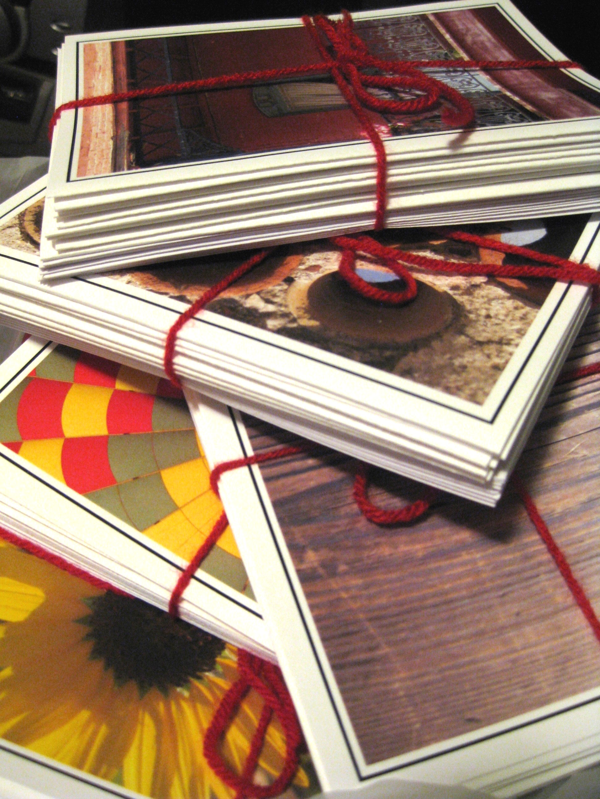
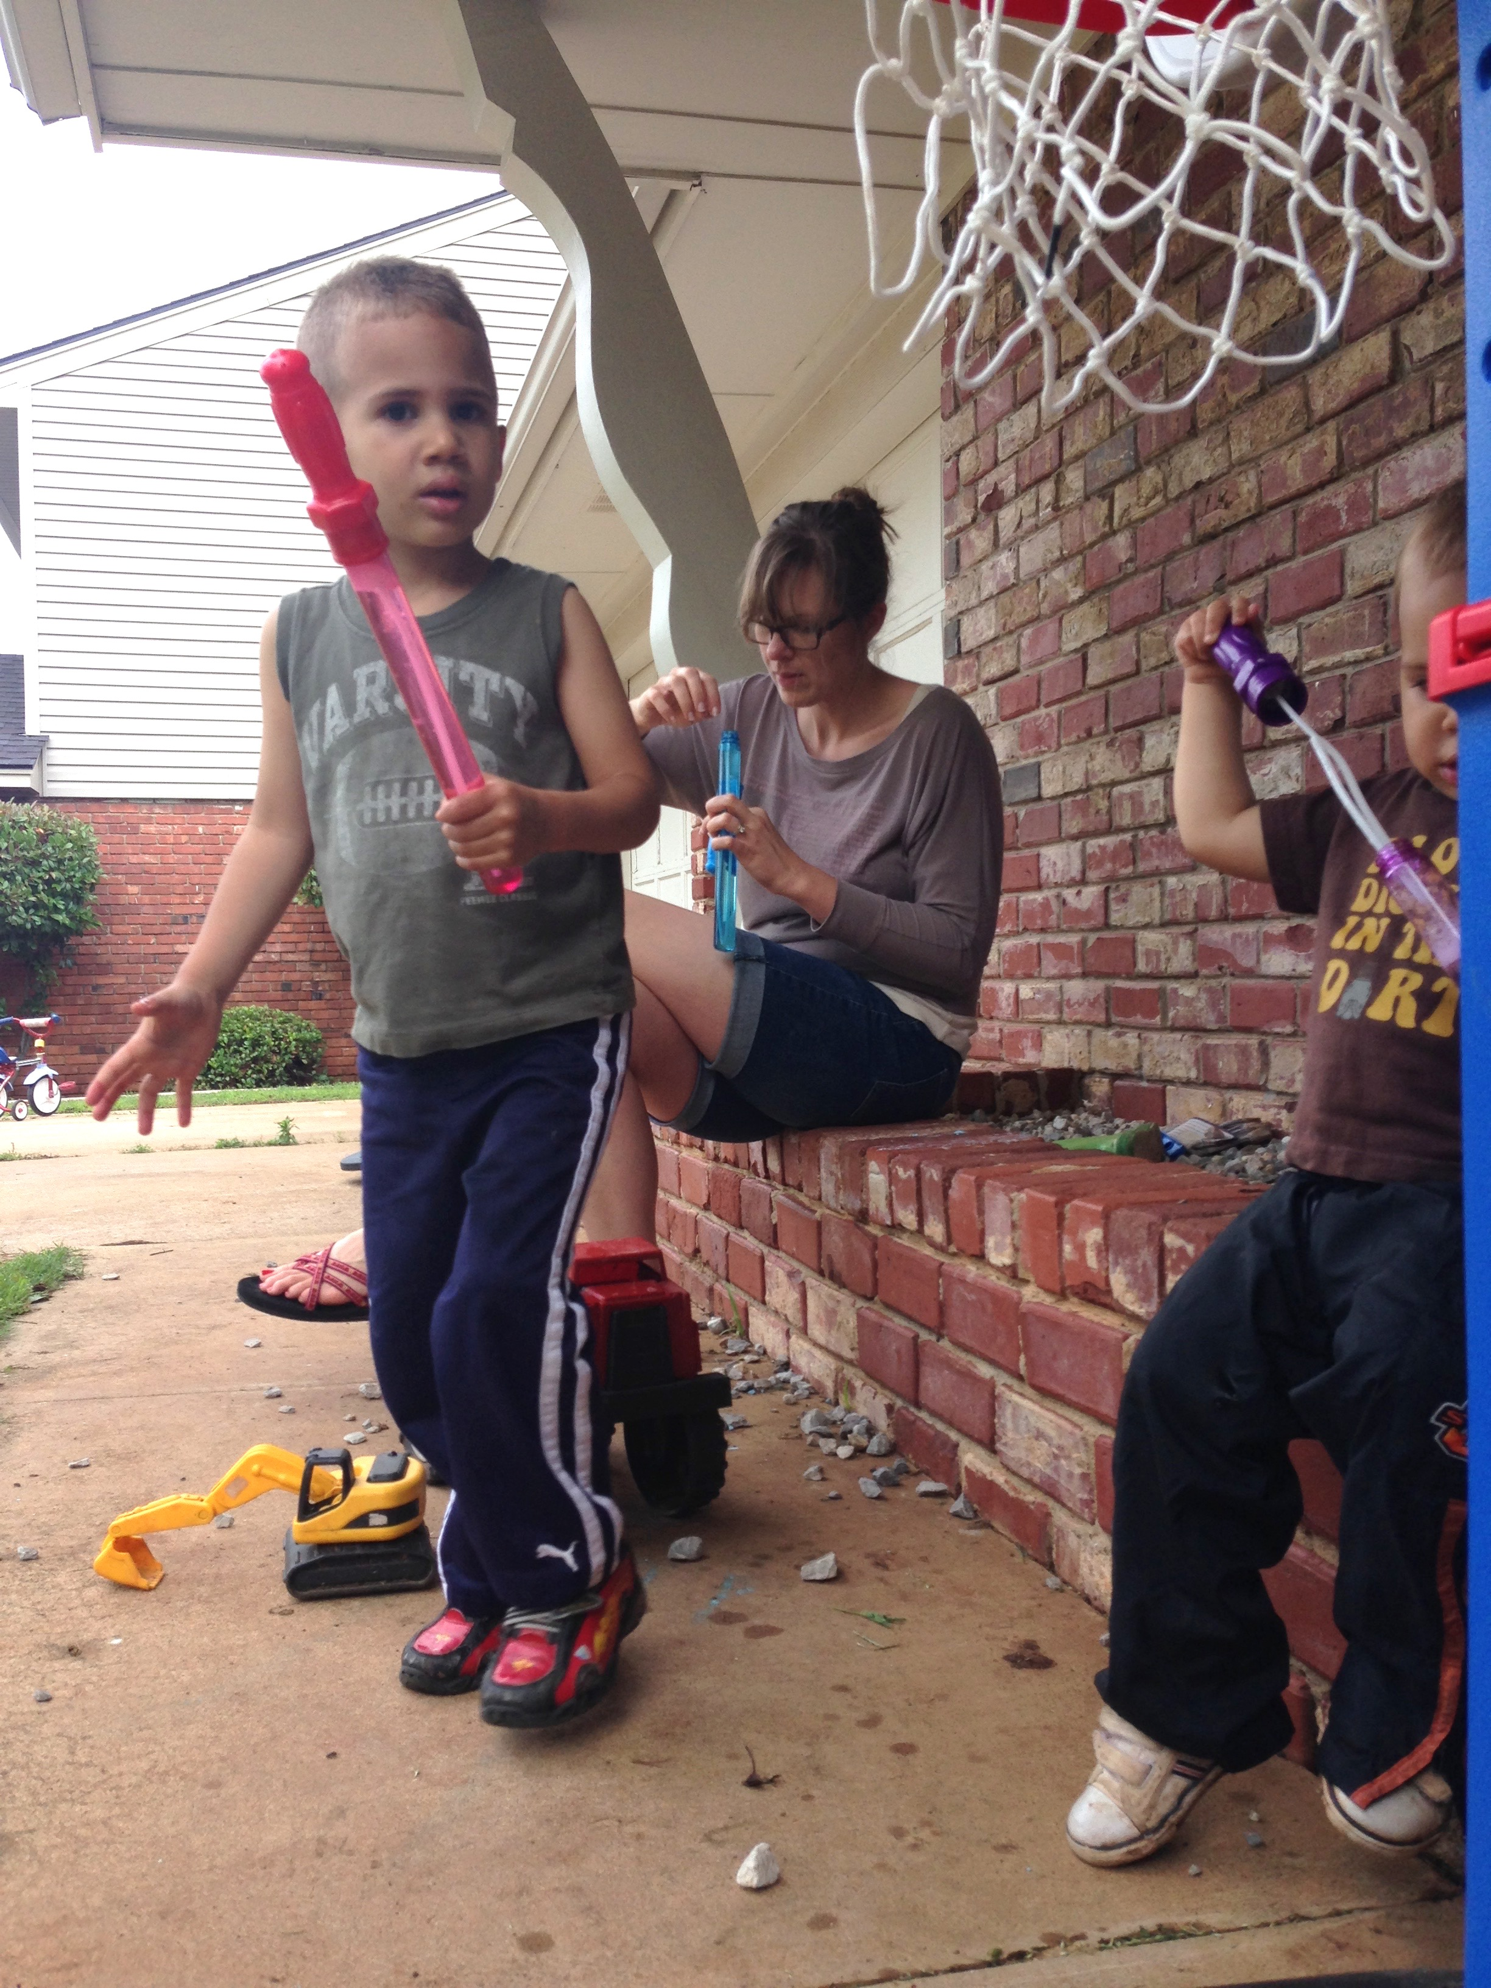
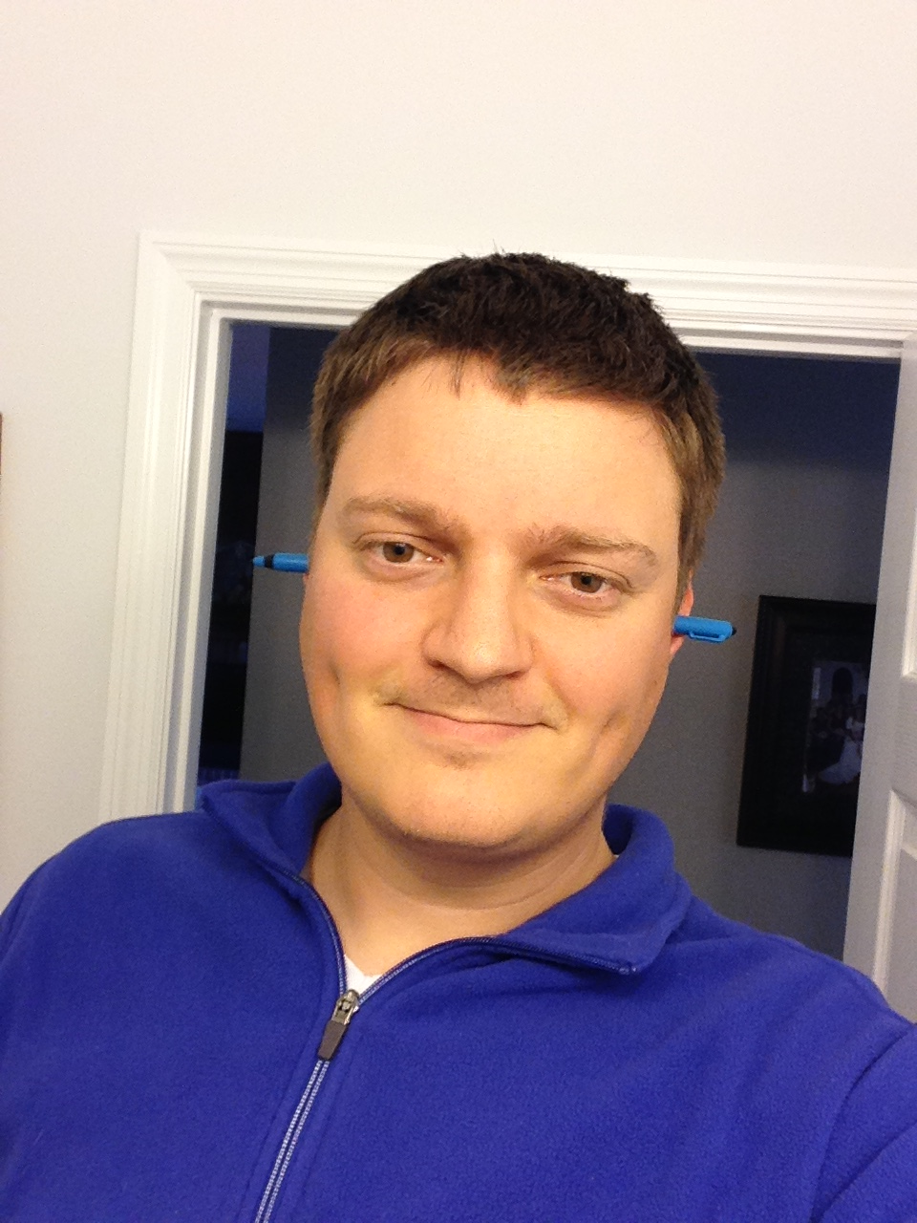
Notes:
Ministry Team Maintenance
Told we had 4 hrs/week to do it by the USCWM, I scheduled that time in each week. Easy at the start when I had less to do, became hard, but I was committed to it cause I felt it was necessary. Even at full support. Partially because of things I did that took time.
Practices I’ve developed to stay in touch:
Birthday and anniversary cards each month. General birthday greeting, and a prayer that I pray over them for the month. Handwritten, different each month. ***Personal Touch***
Monthly prayer email to financial and prayer supporters
Two newsletters each year - mid year and end of year – to whole network; only mail end of year one
Christmas gift - book, ornament, cards, buy something on their behalf, ear gags… (PIC)
Annual visit to see supporters in the main loop, and to do new appointments if needed (PIC)
Faithful supporters
Increasing support: Move to CA (DID THE VISIT/TOUR THING AGAIN)
asking my current supporters to increase. A surprising number did. A few people I asked for specific amounts, and they did it.
New support - Again requires that extended network. Ask God to build that for you, and do your part. Friends and involvement in church for me

Slide 16
Ministry Team Maintenance
Create the Conditions for Provision
Disciplined action
Regular communication
Cultivating a network
ESPECIALLY when it does not feel urgent
Notes:
Disciplined action – Again – set time aside, even when it is going well.
Communication – seen people ignore it for a long time and then they come to a crisis. Wonder if people are more faithful in support in support if you are faithful in communication. I haven’t tried stopping!
2 Cor 9:6 - Whoever sows sparingly will also reap sparingly, and whoever sows bountifully will also reap bountifully.
Network – IS a struggle. Ask God to help you build AUTHENTIC relationships. MTD doesn’t stop.
ESPECIALLY when it doesn’t feel urgent, for all of these points

Slide 17
Leading Others
Create the Conditions for Successful MTD & MTM
Policies – Training requirements, Onboarding policies, Time for MTM
Tools – Communication pieces
Accountability – Track Support, Clearly understood markers for action
Encouragement & Communication – Take the responsibility to ask about it and encourage
Notes:
I have not done much coaching of others on raising support, but I have tried a little, observed a lot, and been led myself. These are four things that I’ve found most important for leaders to do to encourage and support those who are developing their ministry teams.
Policies – In MTD and MTM.
MTD and MTM is part of their job, give them time to do it in work hours
4 hrs / week might be more than is needed. At the least, 2 hrs/week
Write cards, thank yous, assess giving, prepare for trips, write newsletters, pray for supporters
Tools – Don’t make them re-create the process
Visuals to share; how to give
Accountability
Make it clear who is tracking support and that persons’ responsibilities in that area
If a person is low, what to do? Who to go to for help? When to raise a flag? To whom?
Encouragement and Communication
Just don’t want to - force the issue. Other reasons need to be solved in different ways:
Low engagement at work - help them re-engage
Personal issues - encourage finding help, make a plan
Too much work - help figure out how to find relief - make a plan
These things should all help people in the MTD phase with creating conditions for a network, training, and discipline; and for those in the MTM phase with creating conditions for discipline, communication, and a network.

Slide 18
Ministry Team Development
Create the Conditions for Provision
A cultivated network
The right training and tools
Disciplined action: Tie yourself to the actions of ‘obedience’, not to the results
Notes:
Final slide, an example of part of the PPT we provide to our people to use in their communication;
Also a reminder of the reason that I developed a ministry team. Each person listening is part of a ministry with a unique vision that is compelling enough for people to enter this process of developing a ministry team.
I’ll end with what I started saying, that while we cannot predict or control how God will choose to provide a ministry team, we can create the conditions in which he often chooses to do so.
I hope this presentation has sparked ideas for how you can be one who helps create those conditions for people in your organization.
Thank you.

Slide 19
Managing Yourself During Support Raising
^{Q&A}
As Leaders and Support Trainers – What to Secure and Establish
Checking on Team Support levels
Staff reporting on support maintenance time
Allocating time for SMD
Share staff experiences

Slide 20
Closing
Join us next month on
October 27 @1pm CST

